Slide 1

TASK MANAGEMENT SYSTEM DATABASE MANAGEMENT SYSTEM MSCS 542L Team Name: The Unstoppables
Instructor : DR.REZA SADEGHI

Slide 2
Team members
Yeshwanthy………………………………puppalayeshwanthy.puppala1@marist.edu (Team Head)
Chandra Shekar Reddy Ganna……………chandrashekarreddy.ganna1@marist.edu (Team Member)
Thirumala Rao Yelisetti…………………..thirumalarao.yellisetti1@marist.edu (Team Member)
Pranay Reddy Kosireddy………………….pranayreddy.kosireddy1@marist.edu (Team Member)
Natraj Adepu………………………………natraj.adepu1@marist.edu (Team Member)
Venkatesh Pendli…………………………..venkateshwarlu.pendli1@marist.edu (Team Member)
Akhil Sai Baru……………………………..akhilsai.baru1@marist.edu (Team Member)

Slide 3
OUTLINE:
INTRODUCTION
ENTITY RELATIONSHIP MODEL
ENHANCED ENTITY RELATIONSHIP MODEL
CREATION OF DATABASE
DATA INSERTION
GRAPHICAL USER INTERFACE FLOW DIAGRAM
APPLICATION DEVELOPMENT
CONNECTION TO DATABASE
SCREEN SHOTS
CONCLUSION
FUTURE SCOPE
REFERENCE

Slide 4
INTRODUCTION
The goal of the Task management system(TMS) is to display the scheduled calendar for different users of the desired week, month or year of individual tasks.
Task Management system is to keep track of all the tasks of users and update it into the Database.
Each user will obtain an identification login that will be used to look for tasks in the calendar and admin users can record all the transactions in the TMS.
Manage projects using dashboards between team members.

Slide 5
Entity relationship Model
The Entity Relationship Diagram shows the workflow of Task Management System which was used to identify the relationship between the entities.
Each Entity consists of different attributes.
It Display the participation level of Each Entity in the Entity set.
We used 11 entities include the users, tasks, roles, permissions, user _ alerts, task _ tags, media, task_ status, personal _ access _ tokens, password _ rests, migrations for implementation of Task Management System.
There are also a variety of attributes including names, specifications, data, passwords, user IDs, addresses, updated details, and many more.
There is a one-to- many relationship that is experienced to the highest level among one-to-one and many-to-many relationships.
Relationship between task and user is M:N, for media and task M: N, for task and task category 1:1, employee and task relationship are N:1. task and task update the relationship is 1:1. These are all related to their fellow entities bringing about a perfect collaboration. There is a one-to-one, one-to-many, and many-to-many type of relationship.

Slide 6
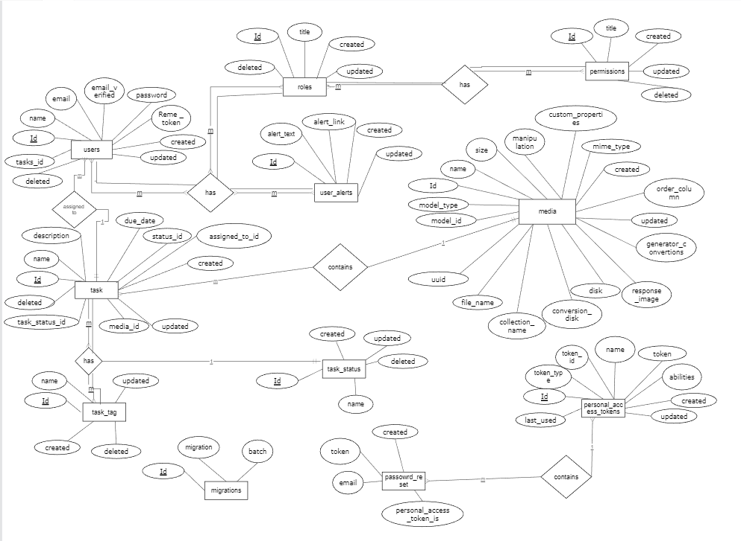
Entity Relationship Diagram

Slide 7
Enhanced Entity relationship model
The EER model is helpful tools for the designing databases with high level models. It provides all the elements of an ER Diagram in the tabular form along with keys like Primary Key, Foreign Key etc.
In Task Management System, the User table id is primary key, for task id is primary key. For task tags tasks_ tag_ id is primary key. Users_ alerts _ id and roles _id is foreign key. For task table id is primary key and media_ id, task_status_ id is foreign key. For Password_ resets Reset_ id is primary key. Created timesetamp, token_ id is foreign key. Media table has Media_ id is primary key. roles table has roles_id primary key.

Slide 8
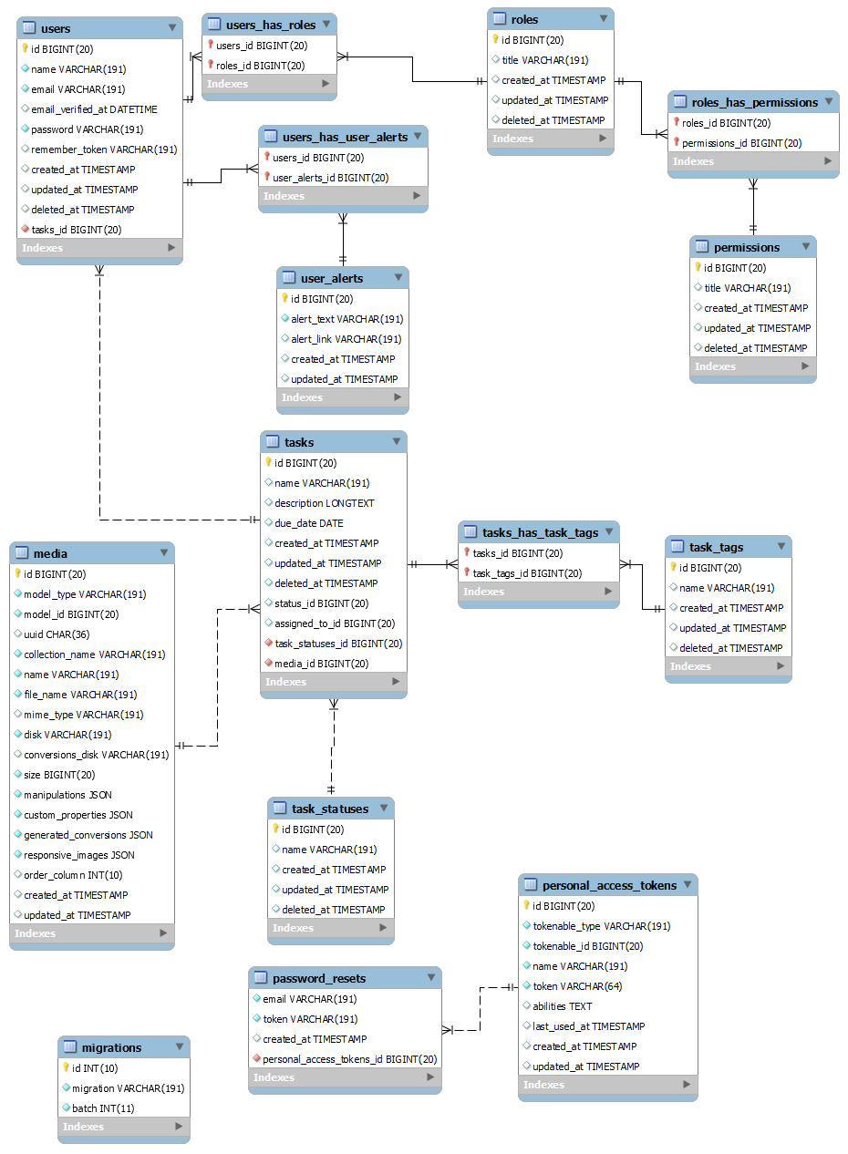
Enhanced Entity Relationship diagram

Slide 9
Creation of the DATABASE
We created Our database with The Name of TMS by using Sql commands. By using the database TMS we created tables like users, tasks, roles, permissions, user _ alerts, task _ tags, media, task_ status, personal _ access _ tokens, password _ rests and migrations.
After creating the tables in the TMS database we inserted the data according to the Column names and their associated data. Confirmed the data insertion by checking the each and every table by using Select * from table name command.

Slide 10
Data Insertion
SET FOREIGN_KEY_CHECKS=0;
Error Code: 1452. Cannot add or update a child row: a foreign key constraint fails (`task_tags`.`task`, CONSTRAINT `fk1` FOREIGN KEY (`mid`) REFERENCES `Users` (`mid`)).
INSERT
INSERT INTO users(id, name, email, email_verified_at, password, remember_token, created_at, updated_at, deleted_at) VALUES(1, 'Dominique1973', 'LaurenMoreland@example.com', '2017-10-30 06:20:16', 'eAH4EPhQ7O4cKKgXZsSmig==','48591FMH3W454YEMT00NY6Z4VC2RU19X38B7K028335S662T55PFBC0TUD4R9EGSZQ7B722612FT0182R1JAL8ZFZZ388KCO14O4Q1C700M11W5742I23JMB7H2I64CIKS3V652', '1985-07-14 13:08:49', '1994-12-23 18:13:05', '1971-01-01 00:00:05’);
Alter User table
ALTER TABLE user_alerts
ADD alert_type varchar(15);
ALTER TABLE Media
DROP COLUMN collection_name;

Slide 11
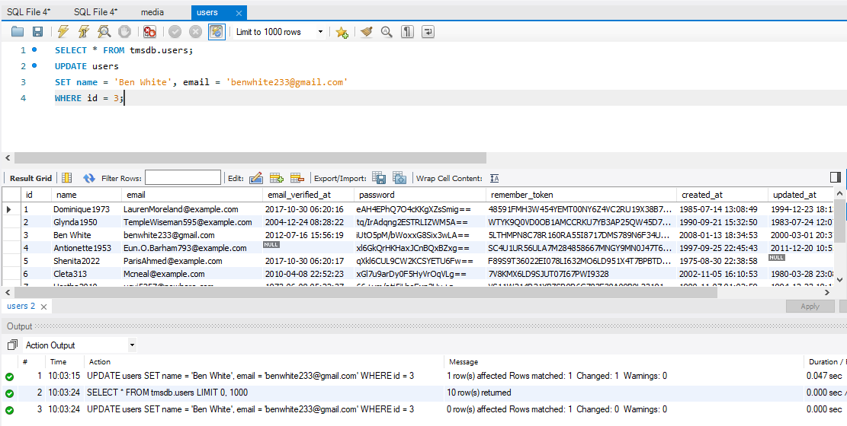
Update Query

Slide 12
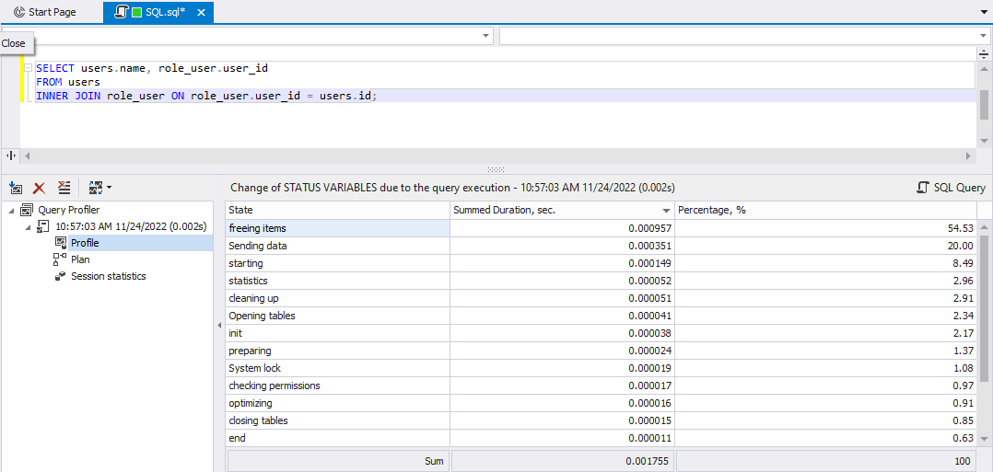
Join Query

Slide 13
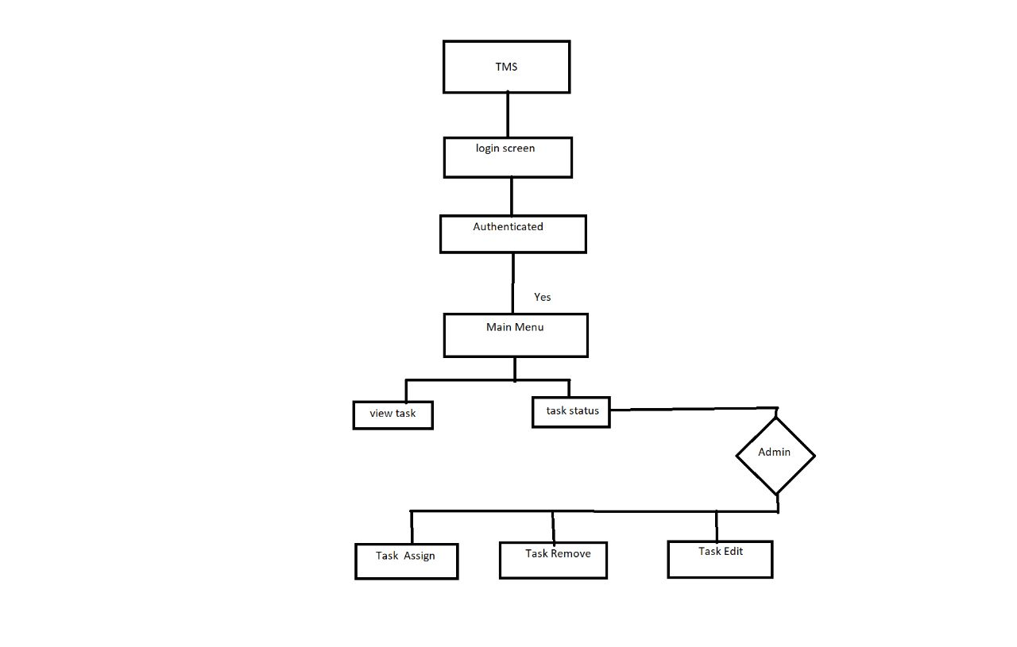
GRAPHICAL USER INTERFACE Flow Diagram
After The Creation of the database, We now implementing the GUI which involves several operations like Assign task, Update task etc.

Slide 14
Application Development
We developed the GUI by using the Laravel Framework, Xamp local server, Bootstrap and Jquery.
Added a Database Connection to the GUI for the GUI to accurately reflect any record changes.

Slide 15
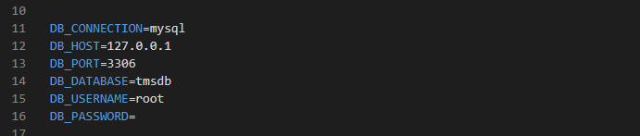
Connection in App Environment

Slide 16
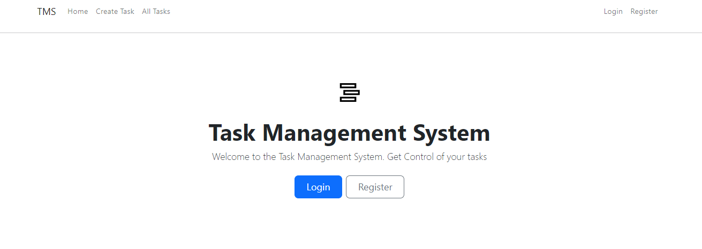
HOME PAGE

Slide 17
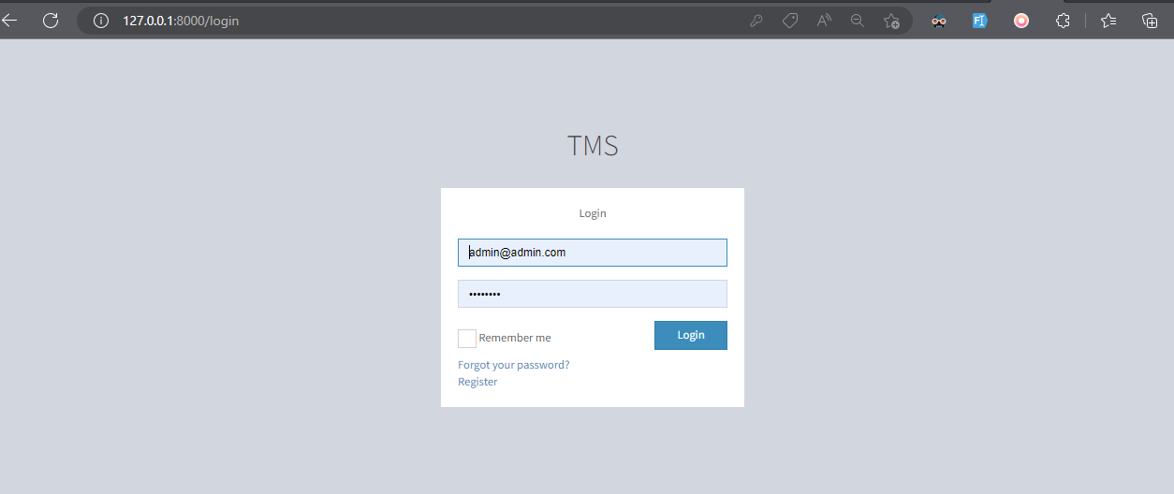
Login page

Slide 18
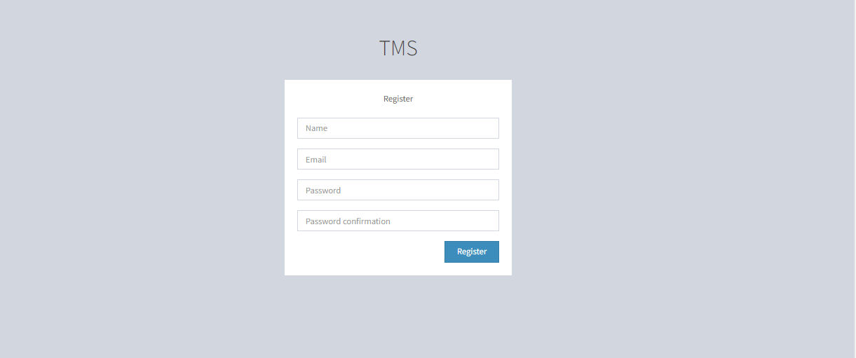
Registration page

Slide 19
CONCLUSIONS
The program has been designed and developed to be online.
This software provide services for individuals and groups.
Finally ,with this application you can create boards to organize anything you are working on and the user does not find difficult to deal with it.

Slide 20
Future Scope
This Project Leaves so much room for development.
We can Implement this system in mobile application
We can develop email triggering system for this application to send email remainders for every task related update.
It would also be ideal for the system to check for individuals assigned a lot of tasks and allocate new tasks to individuals with the least number of tasks

Slide 21
References
https://www.consumervoice.org/wrike-review.
https://project-management.com/calendar-software/

Slide 22
THANK YOU

